Slide 2
Presentation Outline
Background
West Antarctica
Amundsen Sea
Methods
Sampling
Bioinformatics pipeline (Indicator/ANCOM-BC)
Results
Family-level analysis
CDW inflow
Inflow versus outflow
Discussion
Conclusion

Slide 3
Southern Ocean
~25% of global marine primary production (Okin et al. 2011)
Responsible for deep-water formation ~18% of the global ocean’s uptake of atmospheric carbon dioxide (Williams et al. 2015).
Considered a high-nutrient, low-chlorophyll (HNLC) zone
Production limited by iron and light availability
Notes:
Despite these harsh conditions, freezing cold temperatures and minimal terrestrial input, the Southern ocean is quite the primary production powerhouse. It accounts for 20% global biomass
equivalent to 11.4 petagrams of carbon yr-1 (Pg C = 10^15)

Slide 4
Amundsen Sea
Dotson/Getz ice shelves
Thwaites * important later

Slide 5
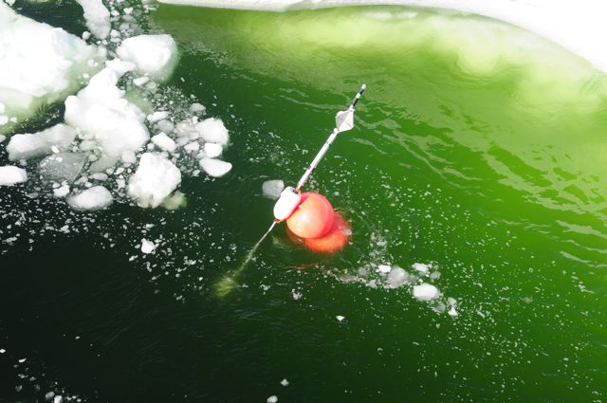
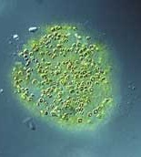
Polynya
What is polynya
Blooms area
Iron and light limited
Important to understand how iron moves in this system

Slide 6
Major iron sources
CDW (two other water masses)
Glacial melt
Sea-ice

Slide 7
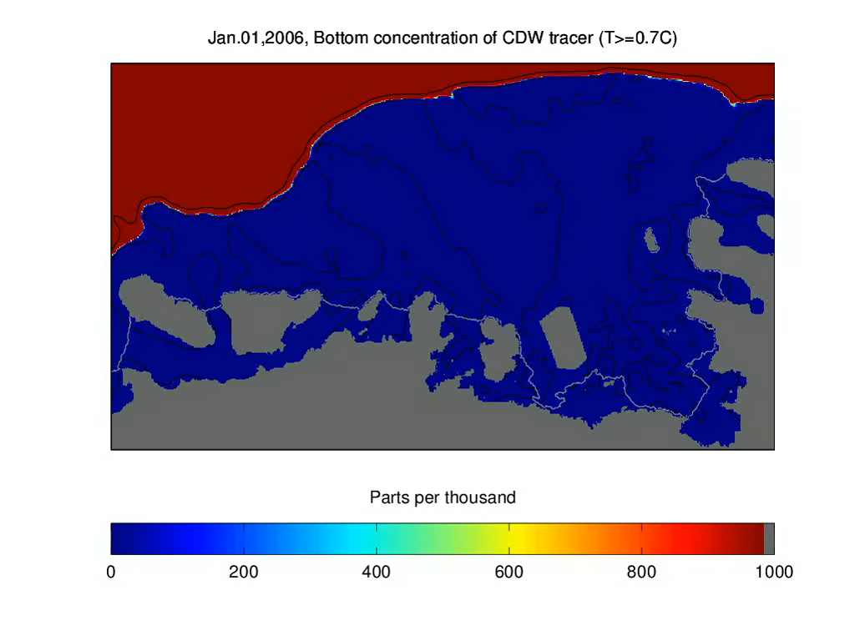
St-Laurent et al. (2017)

Slide 8
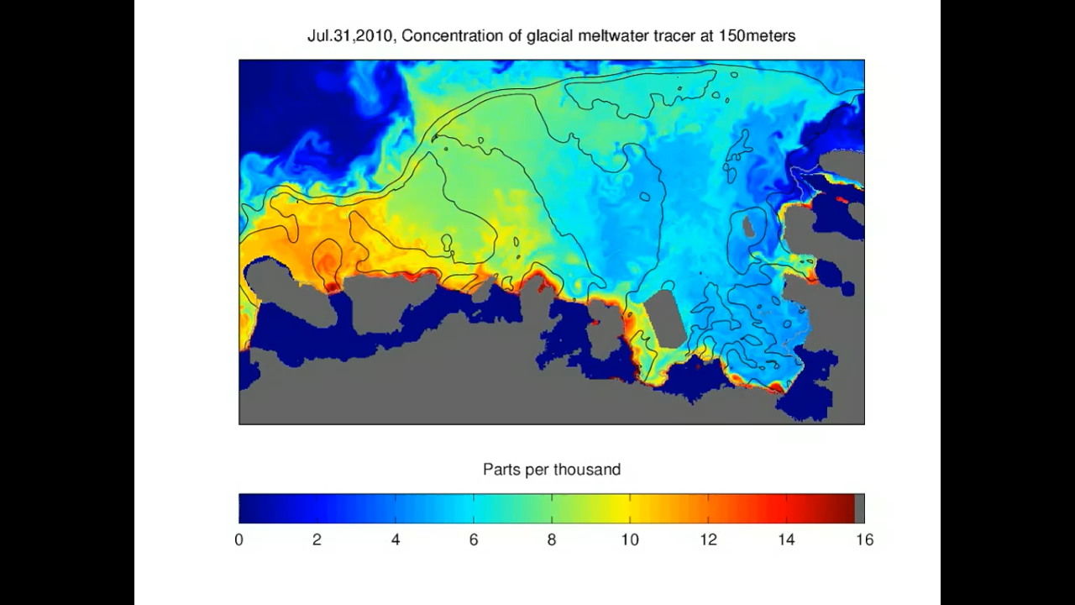
Video of glacial melt

Slide 9
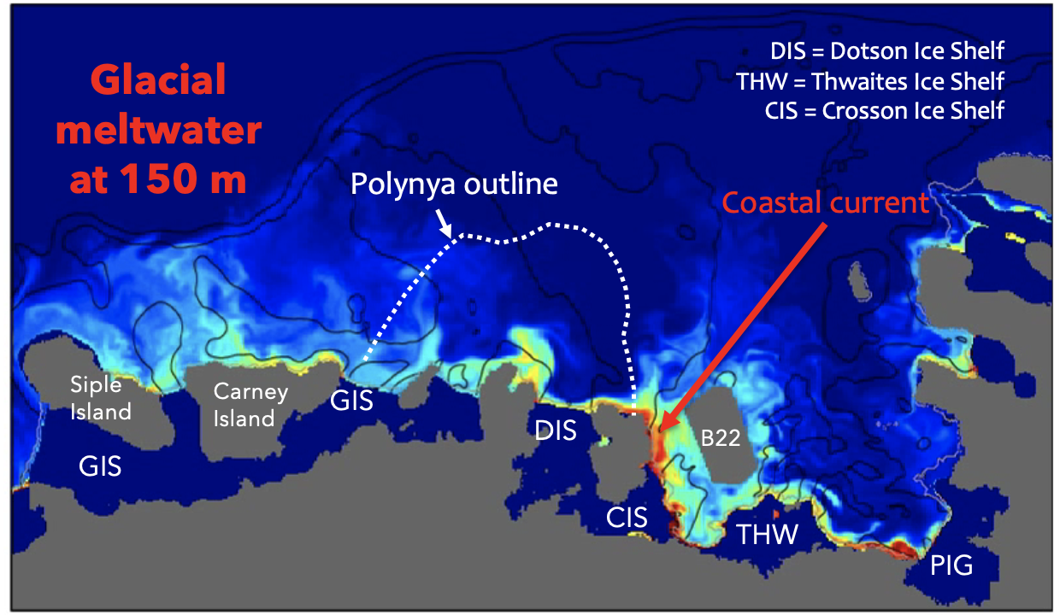
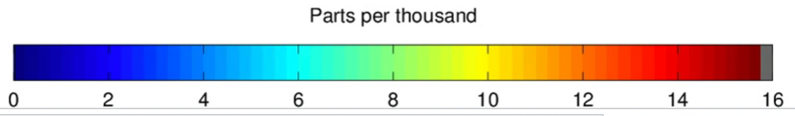
Coastal current
Meltwater-rich plume

Slide 10
Three main water masses

Slide 11
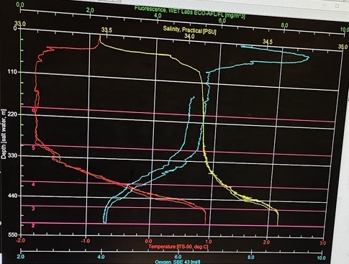
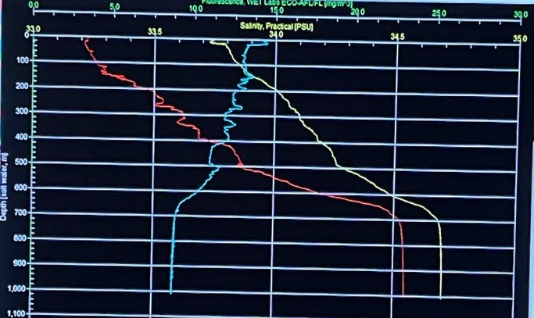
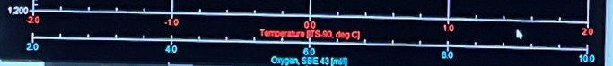
←“Classic” 3-layer ocean depth profile
warm, fresh, high O₂ surface water (AASW)
cold, saltier Winter Water (WW)
warm, saltier, low O₂ Circumpolar Deep Water (CDW)
AASW
WW
TEMPERATURE SALINITY OXYGEN
“Eastern notch” Station
AASW
CDW
WW?
TEMPERATURE SALINITY OXYGEN
Heat + Melt impacted ocean profile →
AASW thinner
WW layer ?
CDW extra warm
CDW

Slide 12
Unique bacterial community
Associated with bloom, but deep-water and Dotson inflow + outflow has not been explored

Slide 13
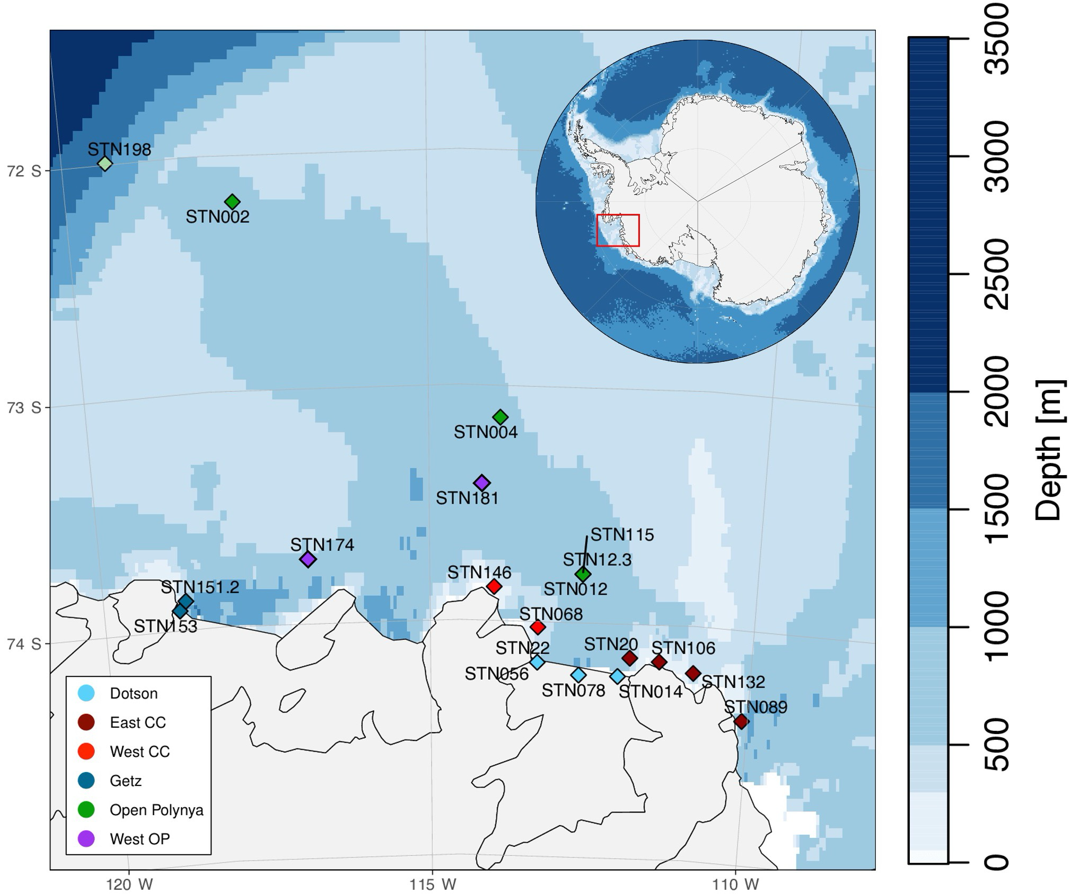
CDW Inflow

Slide 14
Inflow/Outflow

Slide 15
Coastal Current

Slide 16
ARTMEIS aims

Slide 17
Hypotheses
Outflow communities at the DIS will be different than the CDW inflow communities.
The bacterial community will change in the CDW as it comes onto the continental shelf, before flowing into the DIS.
High and low iron water communities will differ. Specific indicator taxa will have iron-related capabilities.

Slide 18
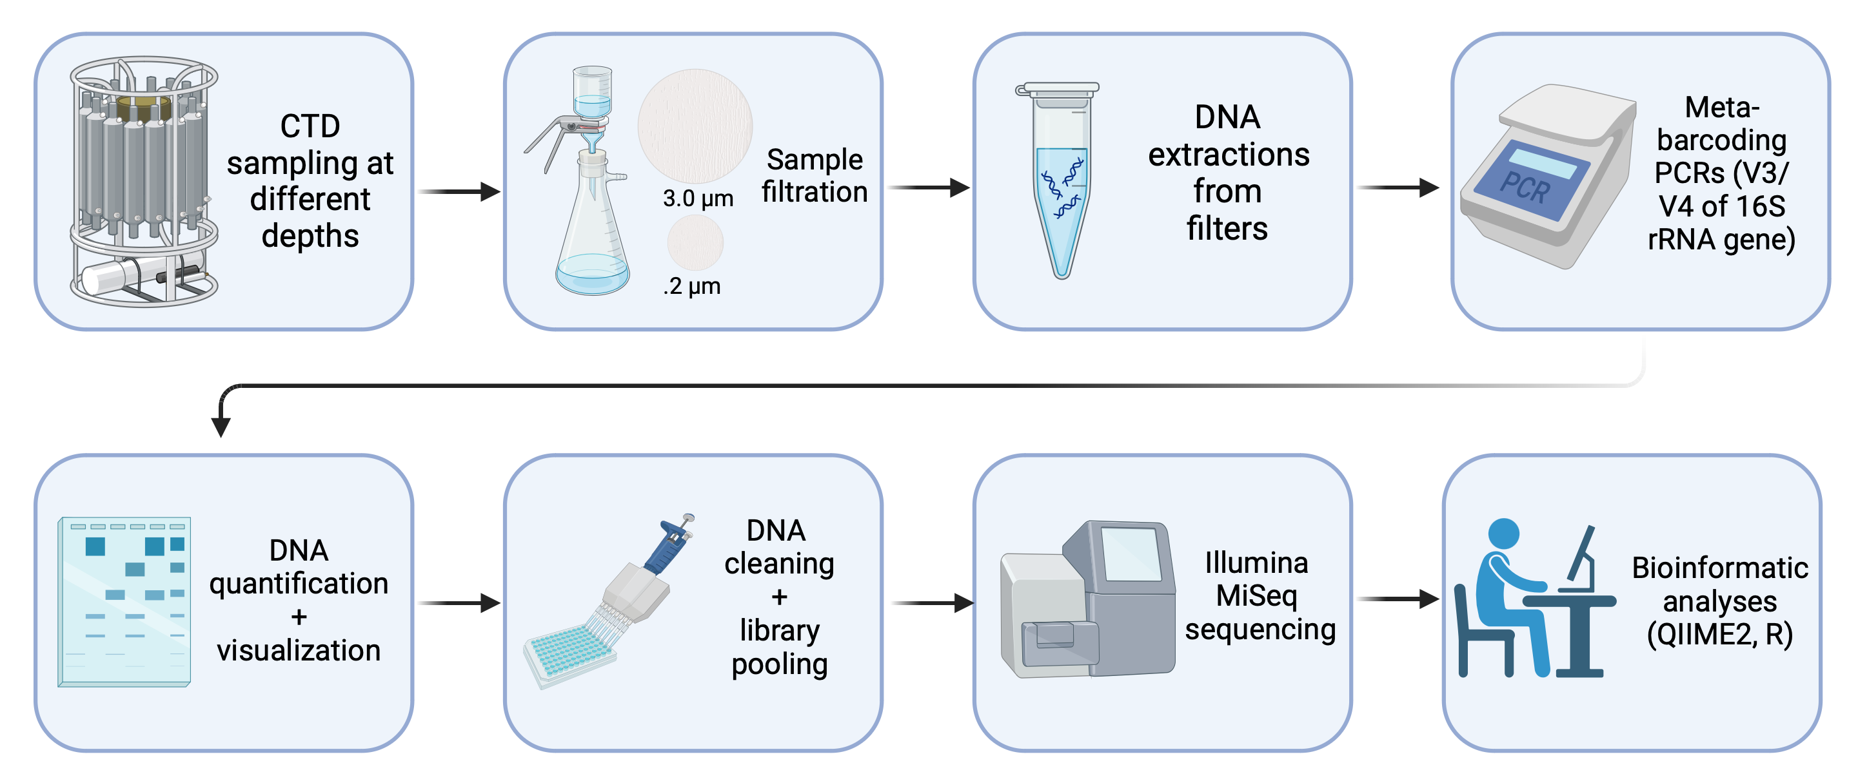
Methods

Slide 19
Samples were collected on the R/V NB Palmer expedition, ARTEMIS (January–February 2022) in the Amundsen Sea, Antarctica

Slide 20
QIIME2
Reads were processed into amplicon sequence variants (ASVs) using QIIME2 and the SILVA v138 database.
Demultiplexed/denoised (DADA2)
Assigned taxonomy from SILVA database (trained classifier)

Slide 21
Methods
For beta-diversity analysis on amplicon and miTag data, Bray Curtis distance matrices were calculated in Vegan and visualized using a principal coordinate analysis (PcoA). Independent permutational analysis of variance (PERMANOVA) based on the Bray-Curtis dissimilarities values were calculated with the adonis function in Vegan (999 random permutations), to test for significant differences in community structure between depth profiles. Finally, a beta-dispersion test (PERMDISP) was applied to confirm that observed differences were not influenced due to dispersion. As a post-hoc evaluation of taxa responsible for differences in microbial community structure, we performed an indicator species analysis. We used the indicator value method⁹² to calculate indicator values using the R package indicspecies. An individual ASV was considered a valid indicator species if the p value was < 0.05 and the Test statistic (the indicator value) was 0.5 or greater, based on 1000 random permutations⁹³. IndVals were compared between two groups, basal layer (30 m) and mid-column samples (180 m and 330 m), with the multipatt function in the R Indicspecies package (with the option control = how(nperm = 999)). This function uses an extension of the original Indicator Value method: it looks for indicator species of both individual site groups and combinations of site groups

Slide 22
Phyloseq / vegan
QIIME2R - takes QIIME output files for compatibility in R
Adonis (PERMANOVA (after betadisper, which studies the differences in within-group variation)
Notes:
permutation refers to a mathematical calculation of the number of ways a particular set can be arranged
PERMANOVA -- significant differences may be caused by different within-group variation (dispersion) instead of different mean values of the groups (see Warton et al. 2012 for a general analysis). However, it seems that adonis2 is less sensitive to dispersion effects than some of its alternatives (anosim, mrpp). Function betadisper is a sister function to adonis2 to study the differences in dispersion within the same geometric framework.

Slide 23
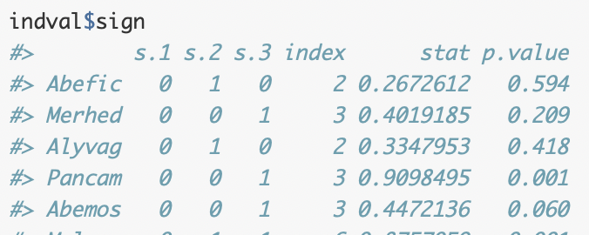
Indicator Species
R package indicspecies
It allows determining lists of species that are associated to particular groups of sites (or combinations of those).
Example output
Adjust p value (reduce false discover rate)
Final indicator species table
Notes:
These authors defined an Indicator Value (IndVal) index to measure the association between a species and a site group. The method of Dufrêne and Legendre (1997) calculates the IndVal index between the species and each site group and then looks for the group corresponding to the highest association value. Finally, the statistical significance of this relationship is tested using a permutation test. IndVal is the default index used to measure the association between a species and a group of sites in multipatt(). However, by default multipatt() uses an extension of the original Indicator Value method, because the function looks for indicator species of both individual site groups and combinations of site groups, as explained in De Cáceres, Legendre, and Moretti (2010).

Slide 24
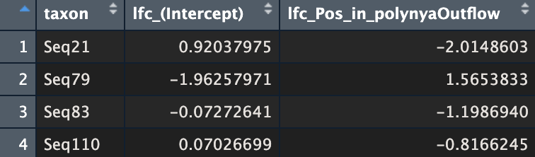
Comparing two categories (i.e. High/Low iron; Inflow/Outflow)
Log transform raw counts
Standardize (z-score)
ANCOM-BC output
Take significant diff. abundant taxa
Visualized with heatmap
Filter ASV table by sig. taxa
Notes:
Log transform to handle skew in raw count data, z-score to standardize data

Slide 25
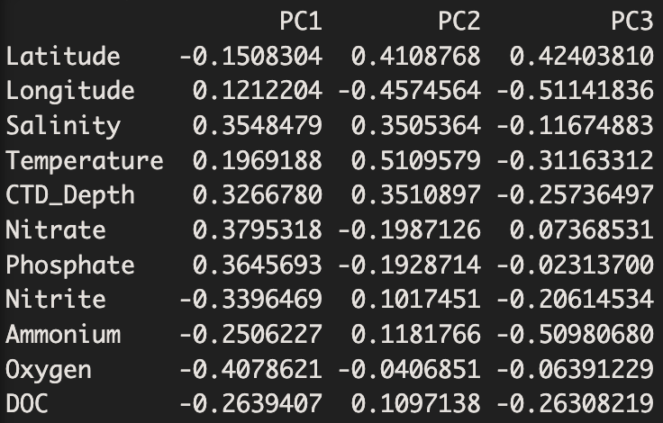
CDW
Notes:
PCA, with watermass as color, vectors are env. Factors
PC1 – (+) Salinity, Nitrate, Phosphate | (-) Oxygen, Nitrite PC 2 – (+) Temperature, Latitude | (-) Longitude
PC 3 – (+) Latitude | (-) Longitude, Ammonium

Slide 26
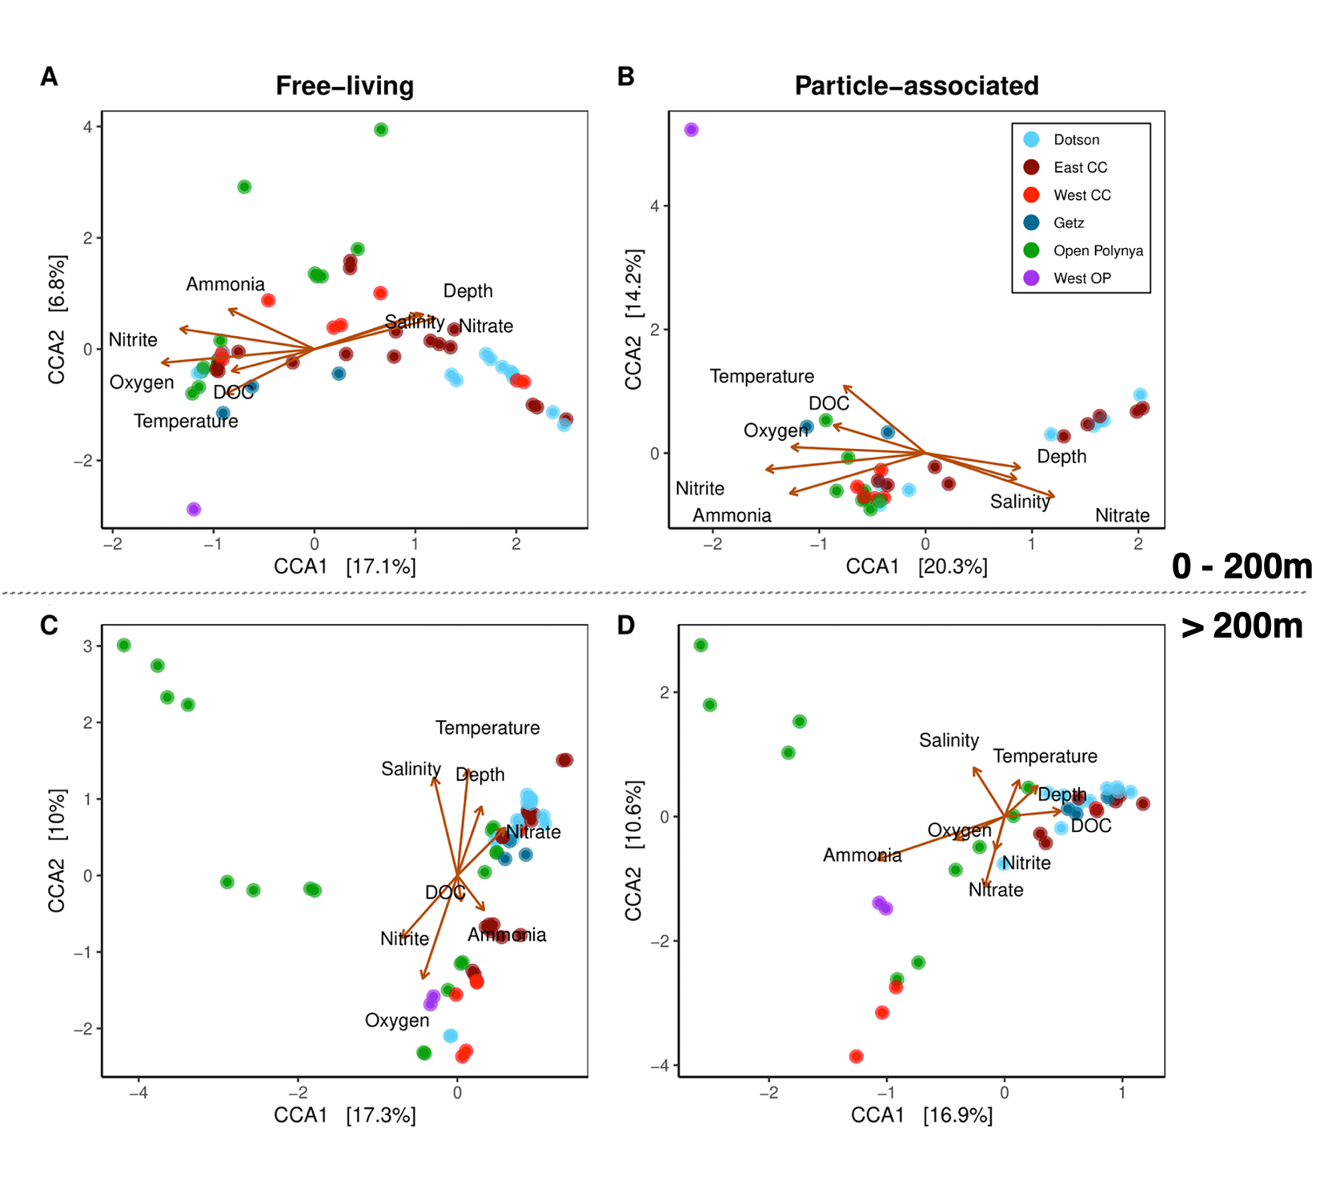

Slide 27
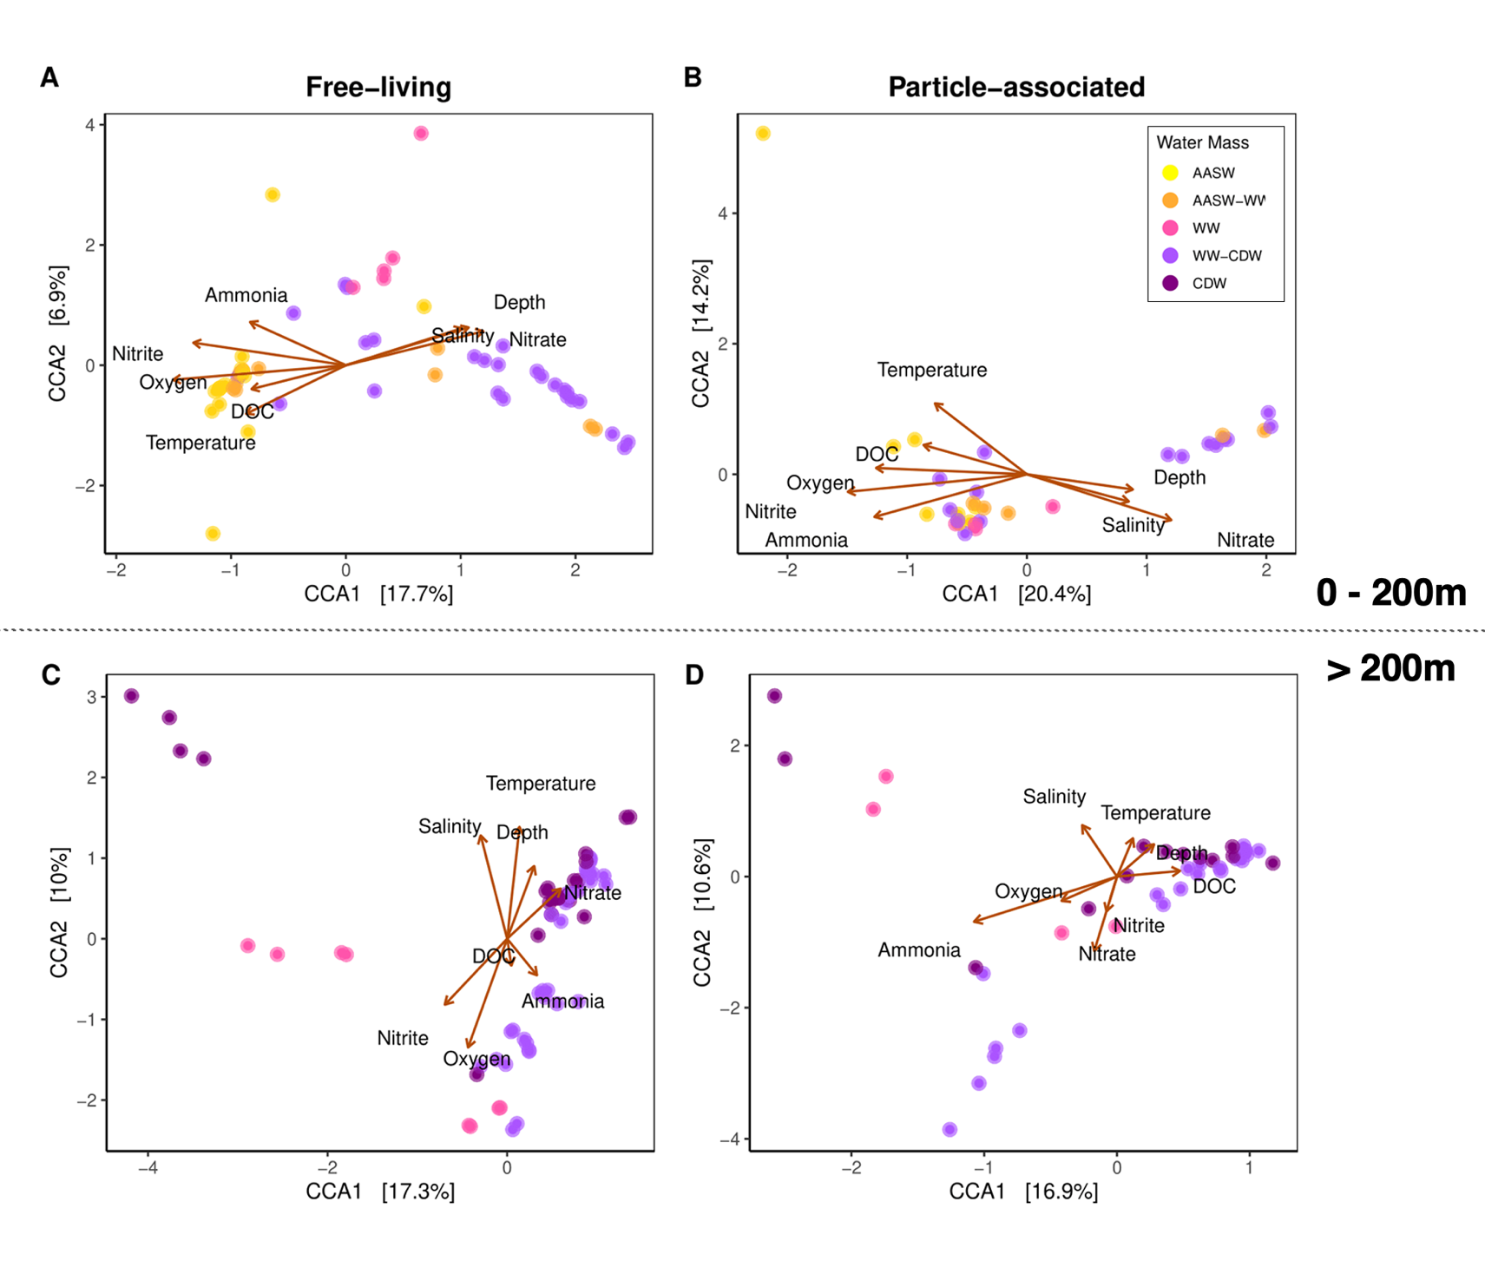

Slide 28
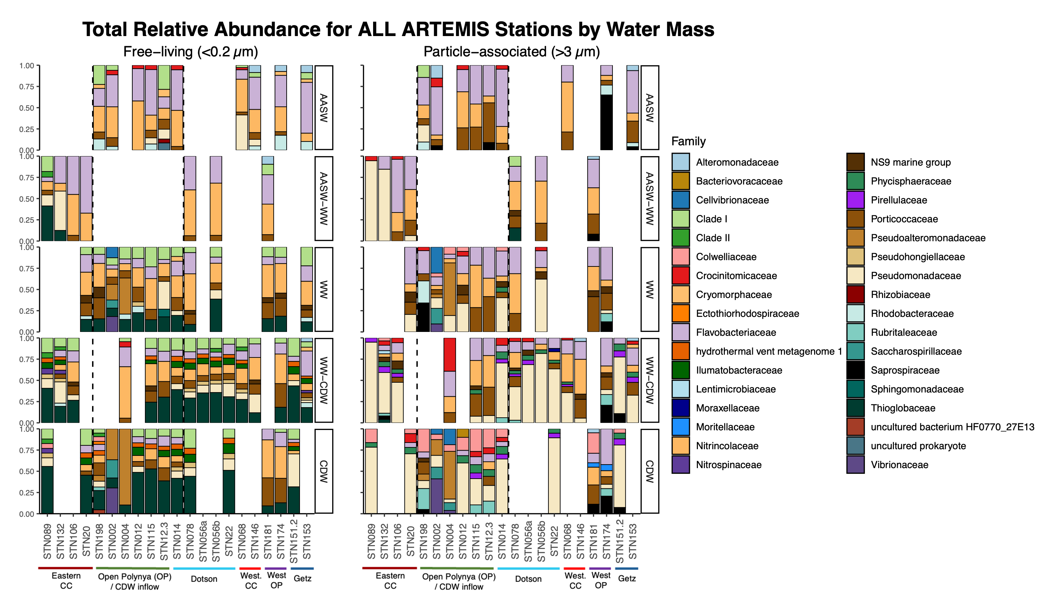

Slide 29
CDW inflow

Slide 30
Inflow/Outflow

Slide 31
Coastal current

Slide 32
Discussion
Limitations

Slide 33
Conclusion
Dotson inflow/outflow communities are not sig. different
CDW inflow community changes as it flows onto the shelf.
Pseudoalteromonas / Vibrio (siderophore synthesis?)
Free-living communities near ice shelf dominated by chemolithoautotrophic bacteria (SUP05; AOA)
Particle-associated communities near ice shelf dominated by heterotrophic bacteria

Slide 34
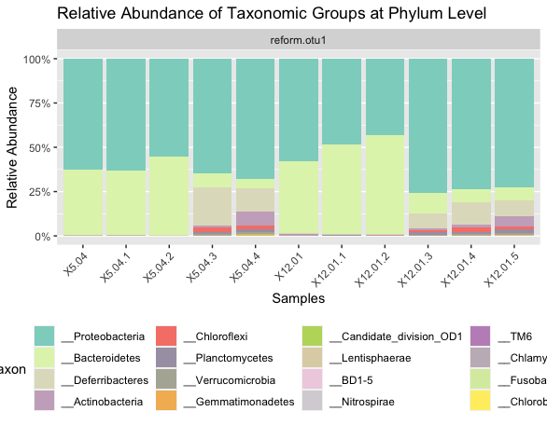
Baby’s first graph :,)

Slide 35
SUPPLEMENTARY

Slide 36
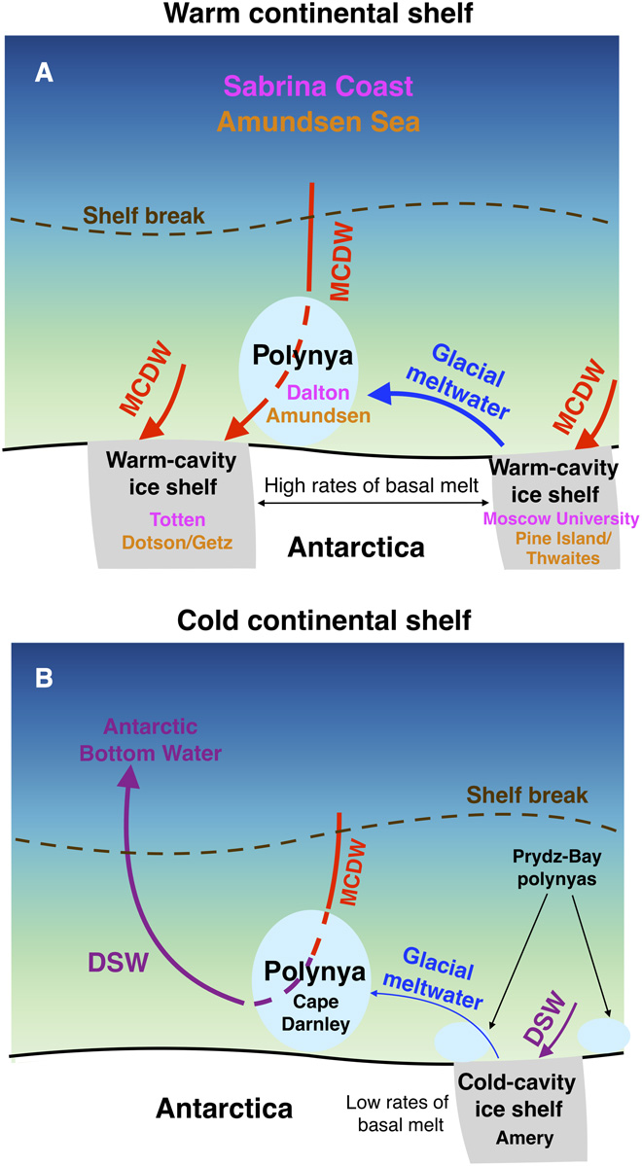
Most of the glacial meltwater released by these ice shelves is transported westward in the coastal current to the Amundsen Polynya in the top 300 to 400 m of the water column (11). [Meltwater exits the cavity beneath the Dotson Ice Shelf south of the polynya (fig. S2A), but the core of this outflow is located on the western edge of the polynya (12) and therefore likely has less impact on convection in the Amundsen Polynya.) https://www.science.org/doi/10.1126/sciadv.aap9467

Slide 37
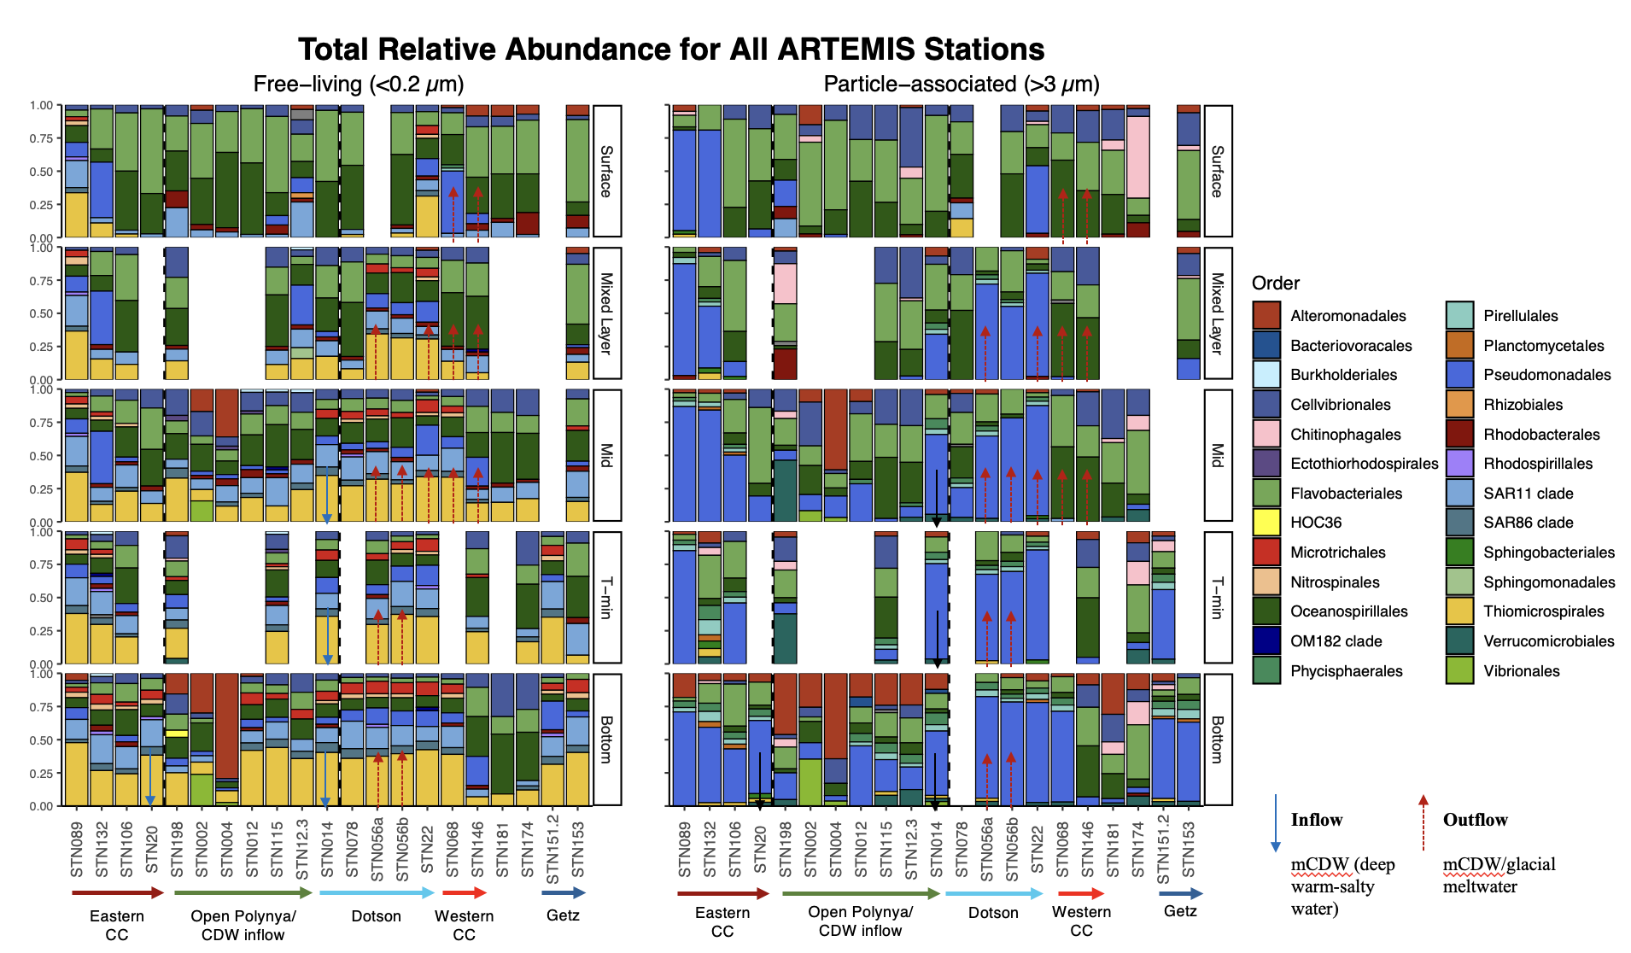
Notes:
** outflow arrows based on velocity profiles.
Relative abundance of Order (free vs particle associated)
free-living >Higher pseudomonas in some of the outflow.
> Microtrichales
> Alteromonadales at depth,
Particle-associated Planctomycetales found in almost all eastern CC + Getz in particle-associated stations
> Vibrio + Aleromonadales are found in different

Slide 38
>40
Notes:
Dissolved iron in surface (left) and mixed layer depth (MLD) (right)
Observing the coastal current – 89 to 68, east to west
The easterlies push water to create coastal current, along the iceshelf upper ~200m, MLD ranges from 90-300m.
Surface
Highest in surface waters toward pine island (eastern notch)
Higher at outflow (56)

Slide 39
Notes:
Dissolved iron concentration in bottom water.
To observe the how the CDW bottom water travels to the Dotson.
- High in open polynya stations (198 is cont. shelf)
High at inflow (SNT 14)
Iron isn’t higher at outflow @ bottom water bc outflow is around 90-400m

Slide 40
